Slide 1
Single Cell RNA-seq Workshop
Nov 2023
Monash Genomics & Bioinformatics Platform

Slide 2
Workshop Summary
What are we covering?
Basics of using Seurat for single cell analysis
QC > Normalisation > Dimension Reduction > Cell Clustering > Differential Expression > Cell type annotation > Dataset Integration
What tools to use?
How exactly?
Some theory, then hands-on.
Demo, and exercises, helpers floating around the room
Based on Seurat tutorial walkthrough
Additional content: SingleR and harmony for cell type annotation and dataset integration (time permitting)

Slide 3
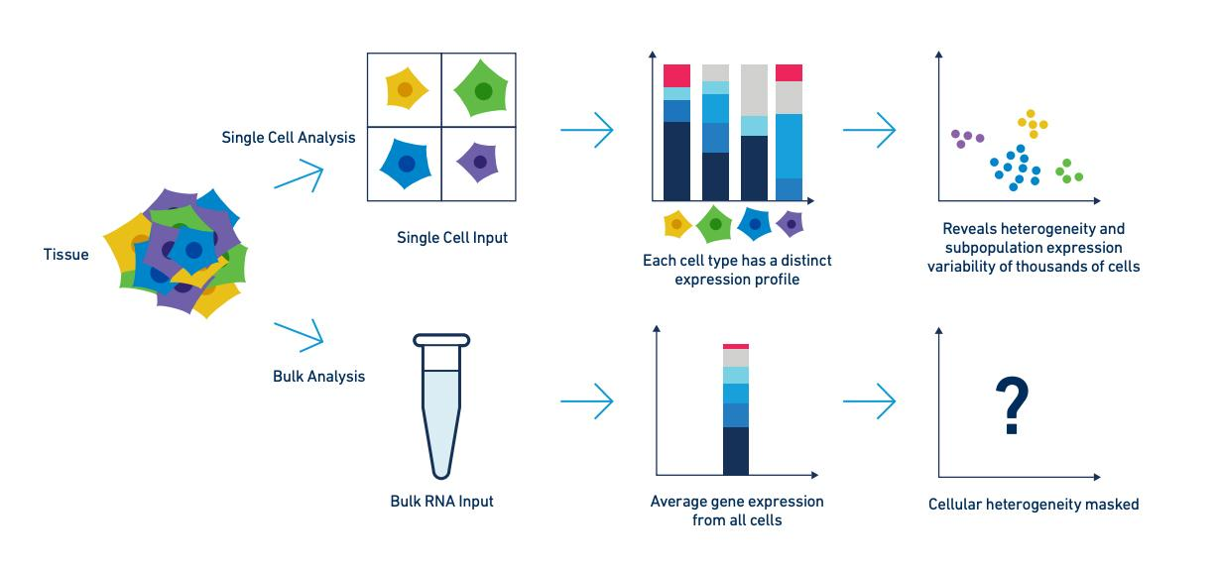
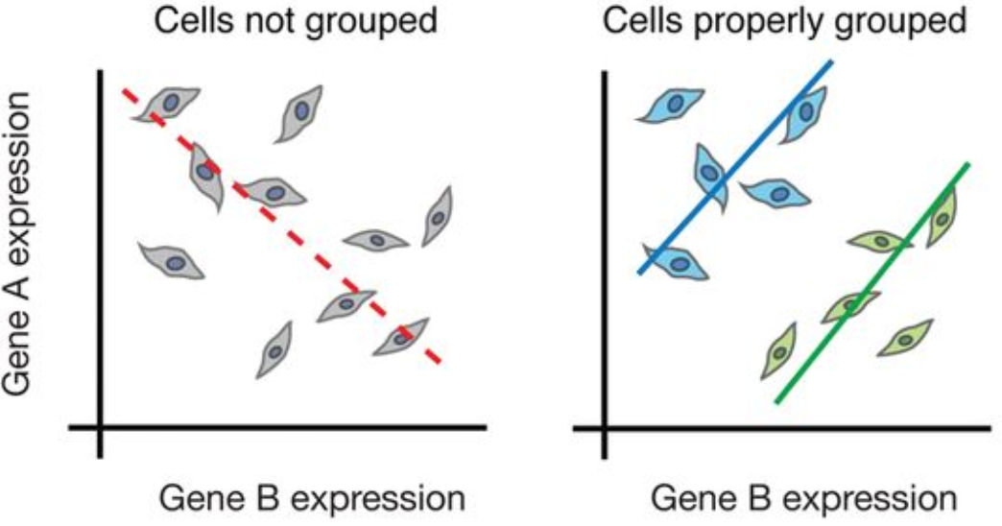
Single Cell Sequencing
Trapnell, C. Defining cell types and states with single-cell genomics, Genome Research 2015
10x Genomics

Slide 4
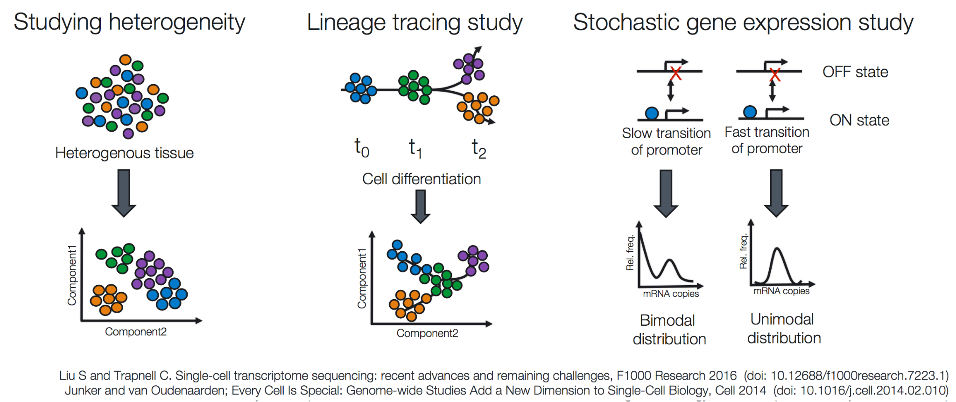
Single Cell Sequencing

Slide 5
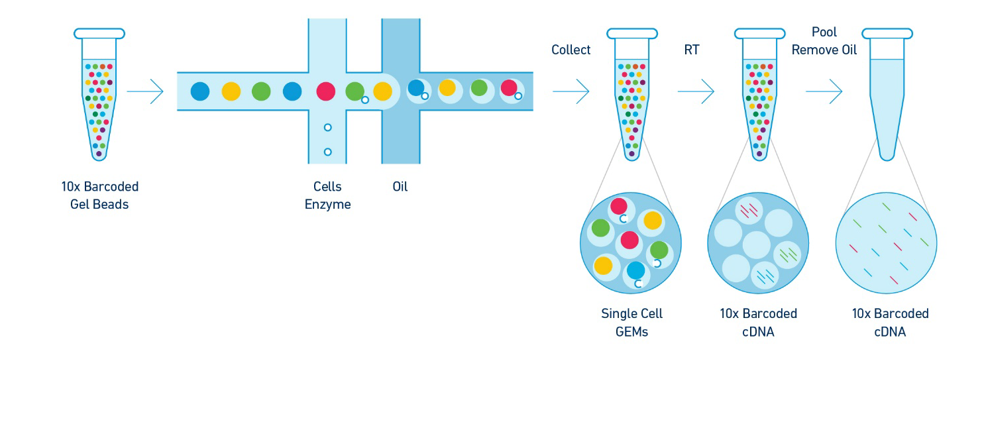
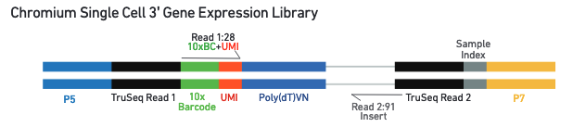
Single Cell Sequencing
10x Genomics

Slide 6
Single Cell Analysis Workflow
Raw sequence
Quality Control
Alignment
Count
Beyond workshop scope
Count matrix
Quality Control
More
Pseudotime trajectories
Single cell velocity
Multiomics
Doublet detection
Cell cycle
Differential accessibility
Immune Profiling
Hashtag demultiplexing
Spatial
etc…
Normalisation
Feature Selection
Dimensionality Reduction
Today’s workshop
Most common steps in analysis
Clustering
Finding cell markers
Cell annotation
Data set integration
Bonus content

Slide 7
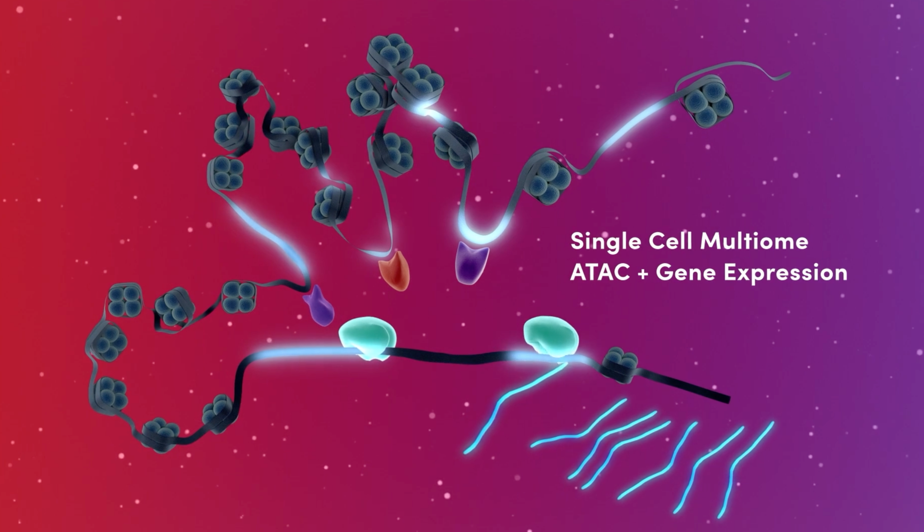
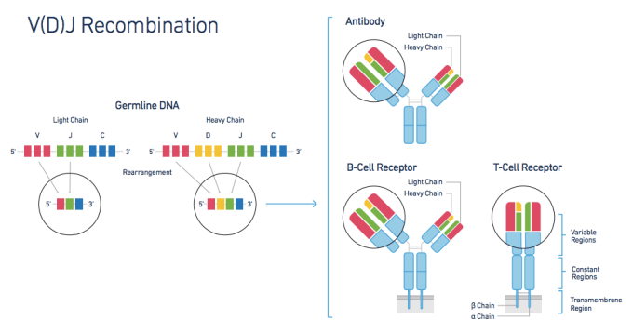
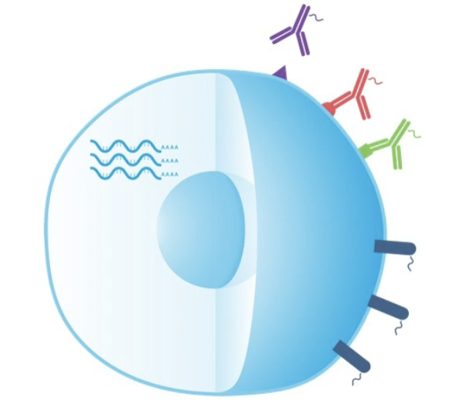
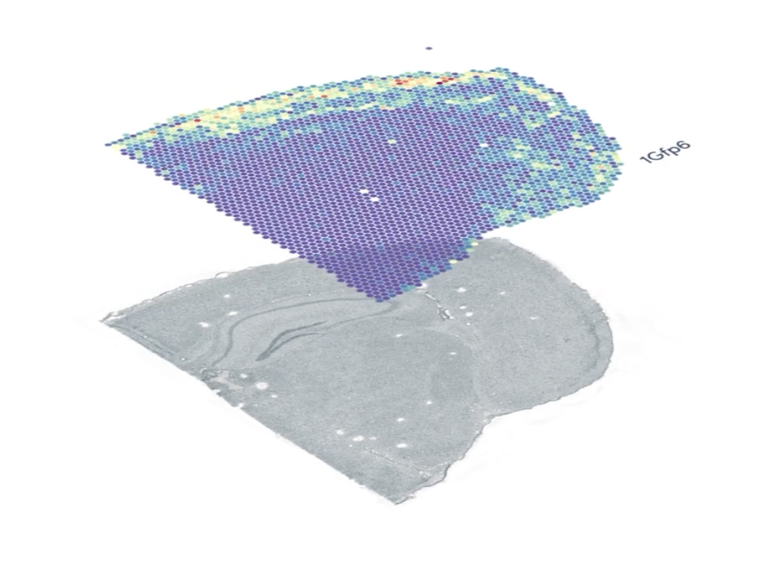
Content We Won’t Be Covering
Different sequencing technologies
Pipelines for processing raw data
Single cell immune profiling, atac, cell surface protein expression, spatial, etc
Further downstream analysis beyond the basic workflow
This workshop is based on the assumption that you have 10x gene expression data generated by Cellranger

Slide 8
The Counts Matrix

Slide 9
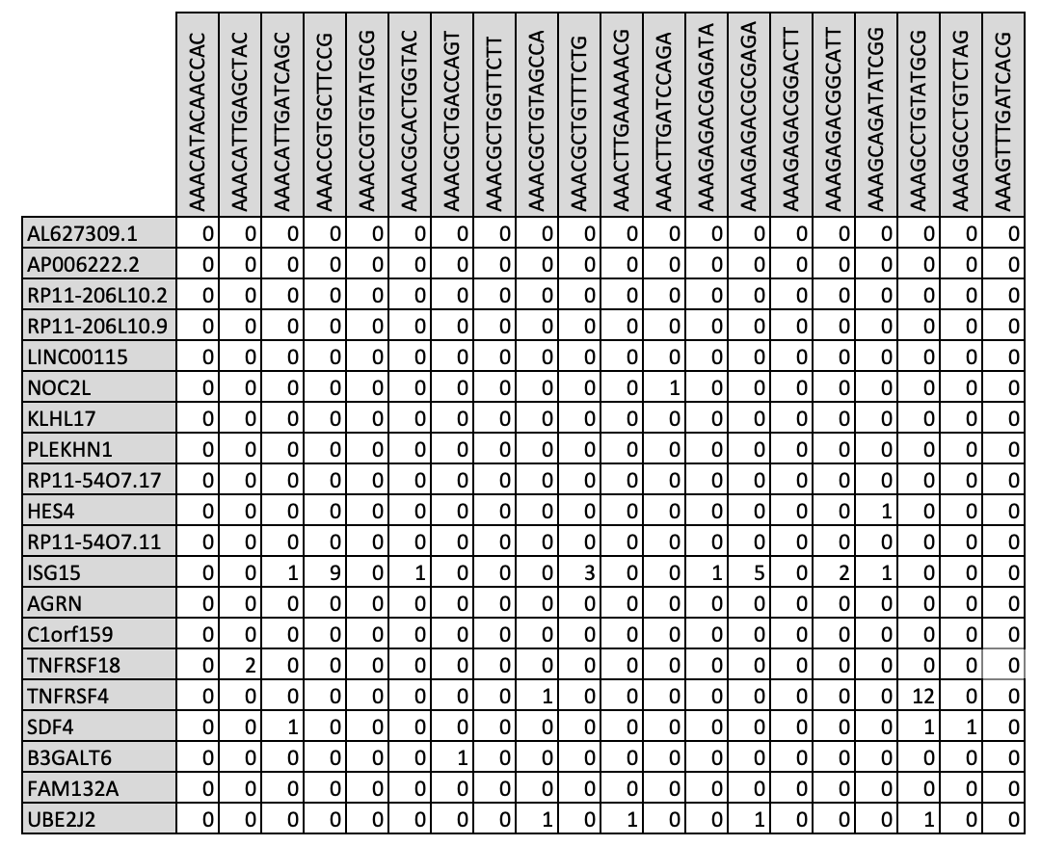
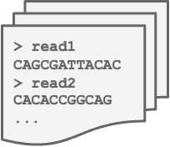
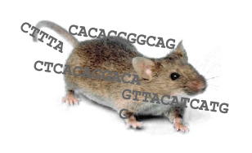
Raw Data to Counts Matrix
Count +
call cells
Align
Pipeline
Pipeline
Analysis
Raw fastq files
Reference Genome
Count Matrix

Slide 10
Counts Matrix - From Cellranger
Sparse matrix format only includes non-zero counts
matrix.mtx
features.tsv
barcodes.tsv
%%MatrixMarket matrix coordinate real general
%
32738 2700 2286884
32709 1 4
32707 1 1
32706 1 10
32704 1 1
32703 1 5
32702 1 6
32700 1 10
32699 1 25
32698 1 3
32697 1 8
…
ENSG00000243485 MIR1302-10
ENSG00000237613 FAM138A
ENSG00000186092 OR4F5
ENSG00000238009 RP11-34P13.7
ENSG00000239945 RP11-34P13.8
ENSG00000237683 AL627309.1
ENSG00000239906 RP11-34P13.14
ENSG00000241599 RP11-34P13.9
ENSG00000228463 AP006222.2
ENSG00000237094 RP4-669L17.10
ENSG00000235249 OR4F29
ENSG00000236601 RP4-669L17.2
ENSG00000236743 RP5-857K21.15
ENSG00000231709 RP5-857K21.1
…
AAACATACAACCAC-1
AAACATTGAGCTAC-1
AAACATTGATCAGC-1
AAACCGTGCTTCCG-1
AAACCGTGTATGCG-1
AAACGCACTGGTAC-1
AAACGCTGACCAGT-1
AAACGCTGGTTCTT-1
AAACGCTGTAGCCA-1
AAACGCTGTTTCTG-1
AAACTTGAAAAACG-1
AAACTTGATCCAGA-1
AAAGAGACGAGATA-1
AAAGAGACGCGAGA-1
…

Slide 11
Counts Matrix
Cell barcodes
Features
Counts

Slide 12
Single Cell Analysis Ecosystems

Slide 13
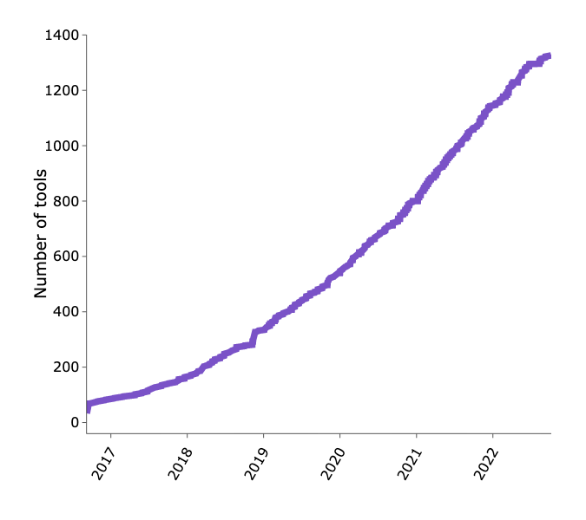
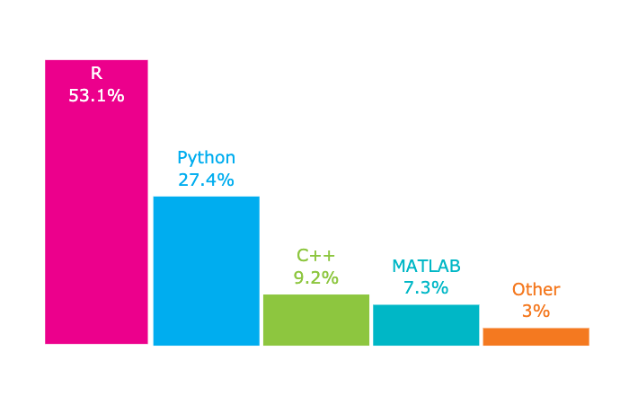
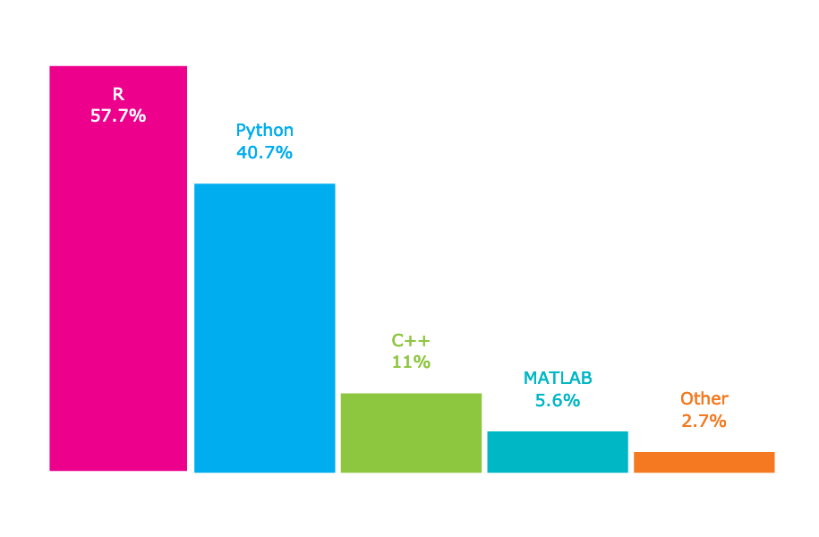
Huge Number of Single Cell Analysis Tools
Oct 2019
Oct 2022 - source: https://www.scrna-tools.org
With so many tools, how do you then pick which one to use?
R is very popular, python is catching up
Most tools are capable of performing general analysis tasks - some will have specialised types of analysis only that particular tool can perform

Slide 14



Single Cell Analysis Ecosystems
Bioconductor: R
Repository of many bioinformatics analysis packages
Single cell packages in Bioconductor make use of the singleCellExperiment class
Seurat (Signac): R
Twin R packages that has decided to make themselves a one-stop shop for most common single cell analysis tasks
Uses the Seurat class
Scanpy: Python
Toolkit for single cell analysis
Uses the anndata class
Large ecosystem of tools that integrate with scanpy
SingleCellExperiment
Seurat object
AnnData
Scran
batchelor
MAST
Slingshot
Seurat/Signac
Scanpy
CellRank
scVelo
Scater
SingleR
Cicero
Cyclone
CellOracle
scrublet
iSEE
chromVar
Monocle
Monocle
Harmony
Cicero
MAGIC
SPRING
PHATE
SCATE
BASiCS
schex
chromVar
batchelor
Palantir
Harmony
bbknn
DropletUtils
zellkonverter
Harmony
schex
Episcanpy
And 100s more…
And more…
And many others…

Slide 15
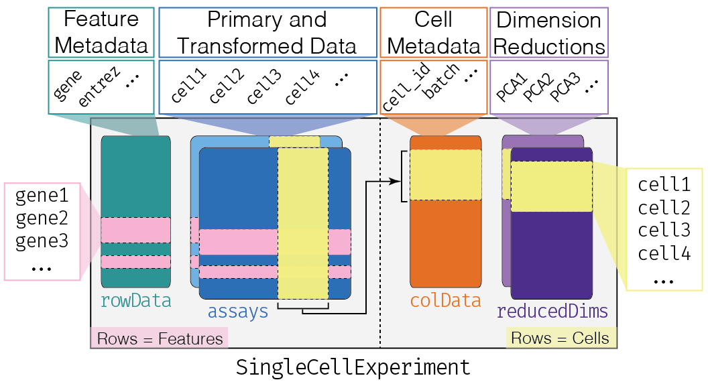
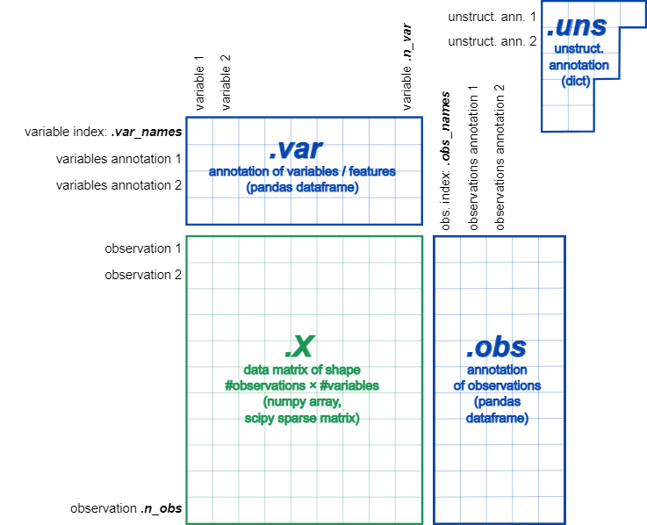
Single Cell Analysis Ecosystems
Each system has a shared central data structure for storing and representing single cell data
Conversion between different data structures isn’t impossible but it can be difficult
Knowing what analysis you want to do downstream can save you a lot of pain if you use the right data structure upstream.
anndata

Slide 16
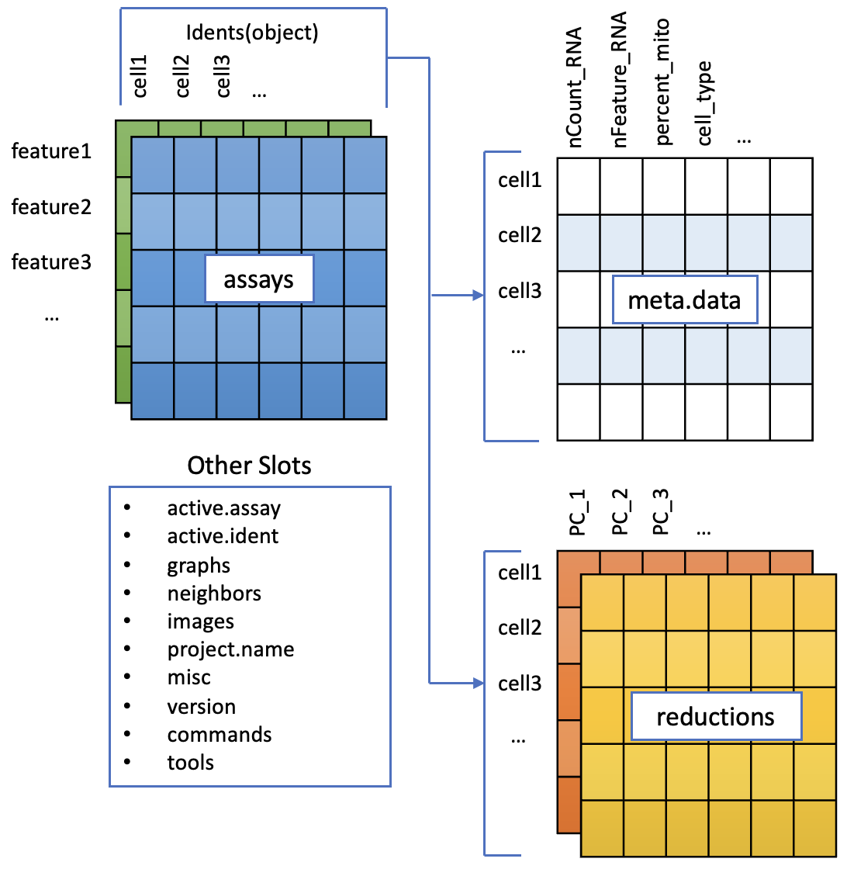
Seurat
Very popular R package
Well documented
Lots of tutorials - we’re working through the PBMC tutorial today
Performs most common single cell analysis tasks
Seurat object - S4 class:
Container for count matrix, normalised count matrix, dimensionality reduction, cell meta-data, etc
Can contain more than gene expression data, will also store ATAC peak counts, cell surface protein counts, spatial images, etc

Slide 17
Analysis Workflow

Slide 18
Counts Matrix

Slide 19

Quality Control
Cells - too much Mt RNA
Cells - too little RNA
Cells - too few genes expressed
Genes - too little RNA

Slide 20
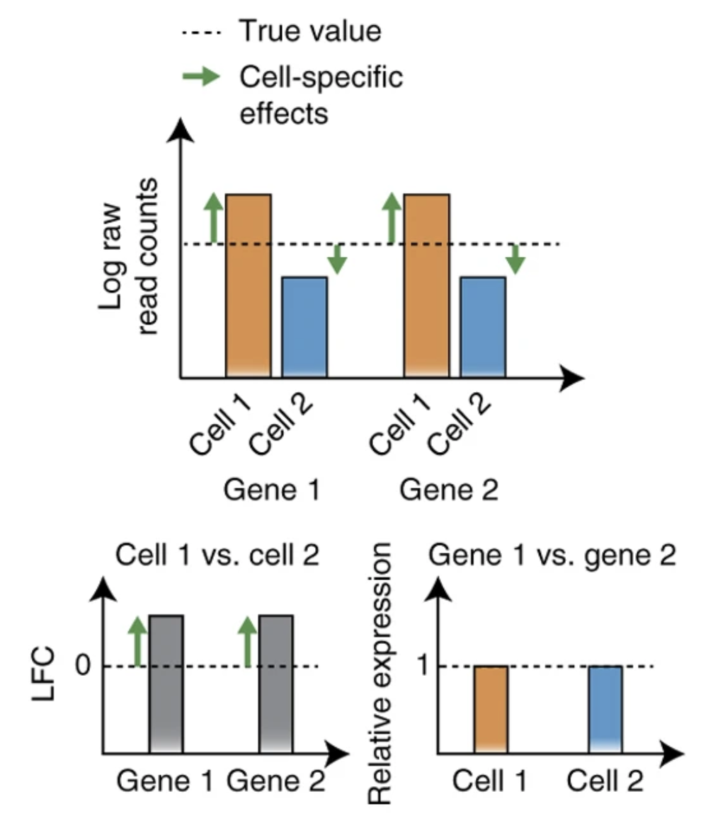
Normalisation
Differences in sequencing coverage between cells due to technical effects (e.g PCR amplification efficiency, amount of mRNA captured, etc)
Library size normalisation: divide counts in a cell by the total counts for that cell
Typically performed by multiplying by 10000 and log transformed in Seurat
Seurat also has SCTransform - regularised negative binomial model
Normalizing single-cell RNA sequencing data: challenges and opportunities. Nat Methods 14, 565–571 (2017)

Slide 21
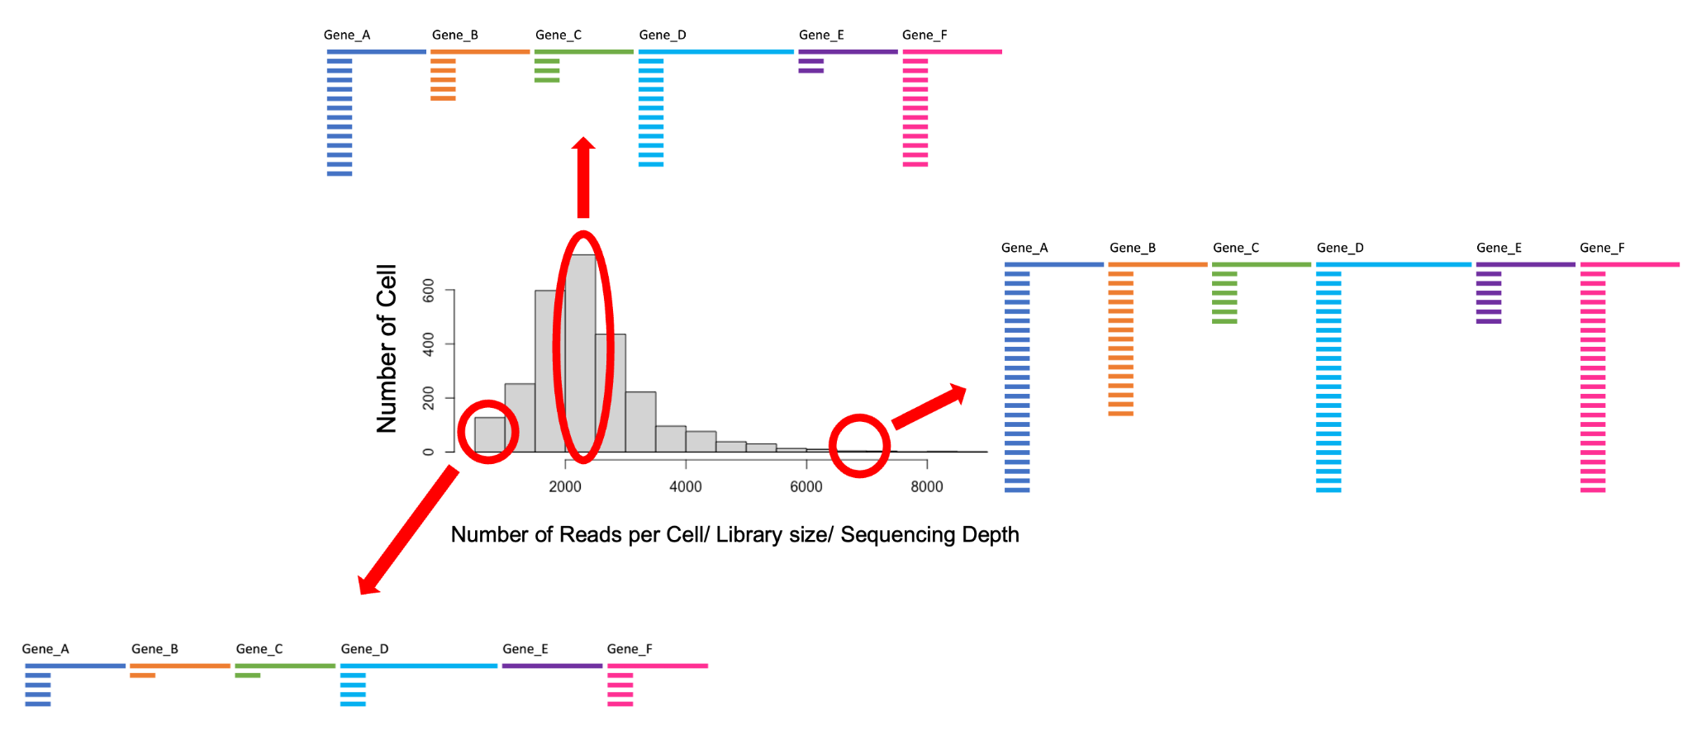
Normalisation
Cells can have differences in sequencing depth

Slide 22
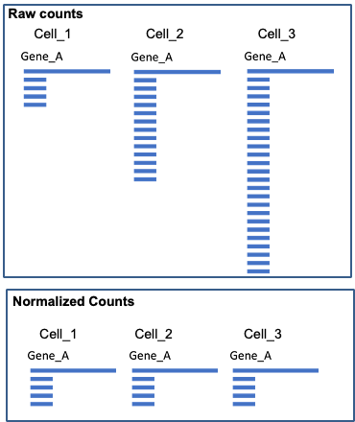
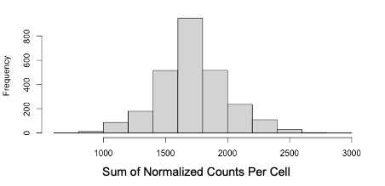
Normalisation
Normalization is required to avoid biases because of sequencing depth and make genes comparable
LogNormalize:
Feature counts for each cell are divided by the total counts for that cell and multiplied by the scale.factor. This is then natural-log transformed using log1p.
Log( Counts of Gene_A / Library Size Per Cell * scale.factor + 1)

Slide 23
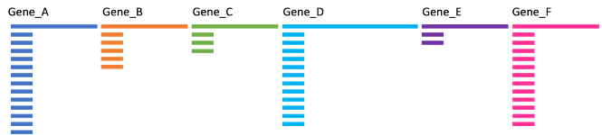
Scaling
To find markers in a cell population you need to compare genes between them
Comparing genes between them when they have different spectrums of expression is challenging

Slide 24
Why Do You Need to Scale
Highly expressed genes can overpower the signal of other less expressed genes with equal importance.
Within the same cell the assumption is that the underlying RNA content is constant
SD of 1
If variables are provided in vars.to.regress, they are individually regressed against each feature, and the resulting residuals are then scaled and centered. This step allows controlling for cell cycle and other factors that may bias your clustering.

Slide 25
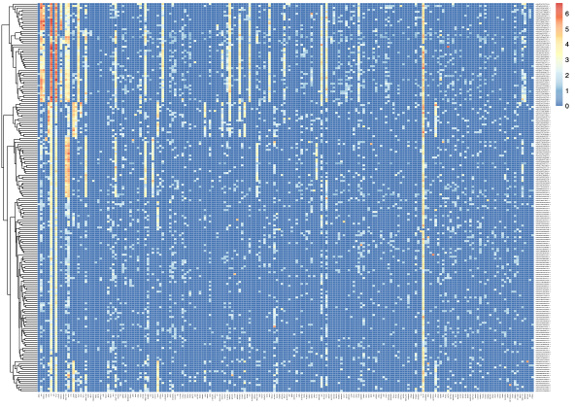
Scaling
Expression of most variable genes in 500 cells (No scaling)

Slide 26
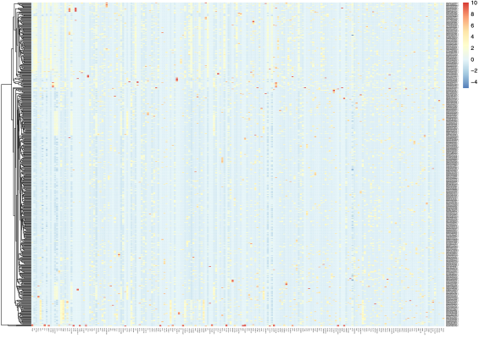
Scaling
Expression of most variable genes in 500 cells (scaled)

Slide 27
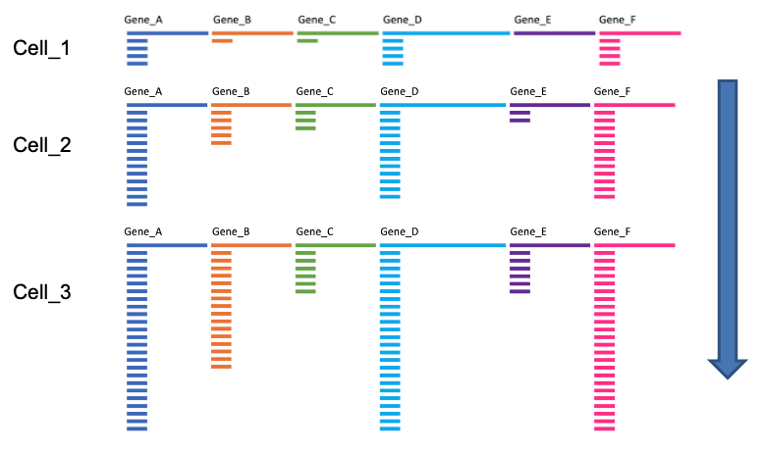
Normalisation
Normalisation corrects for biases in this direction

Slide 28
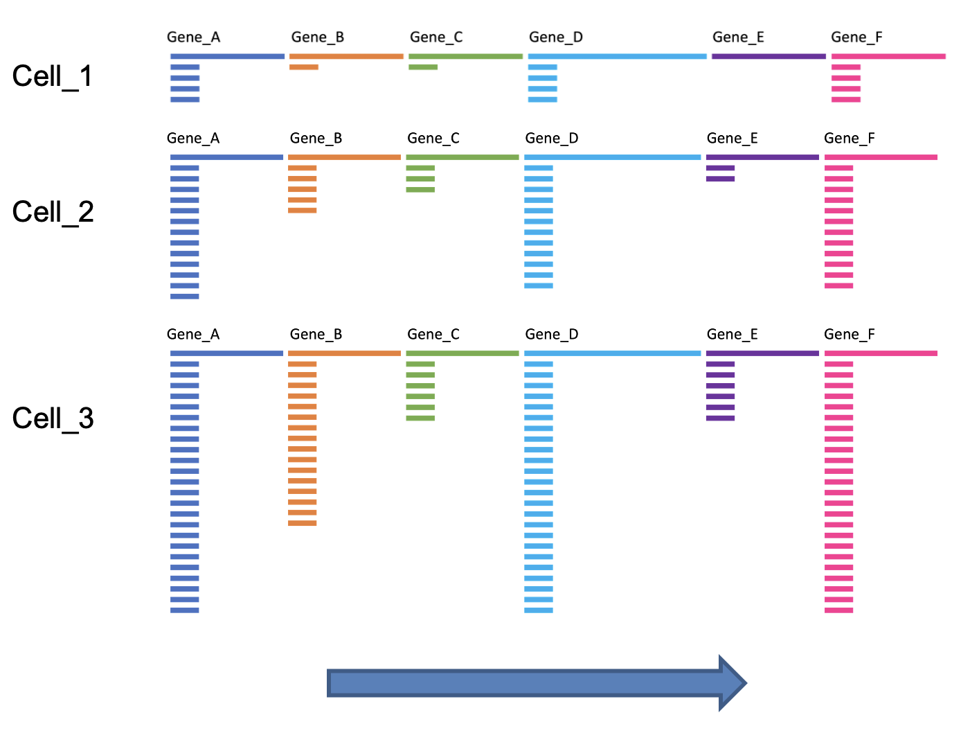
Scaling
Scaling corrects biases in this direction

Slide 29
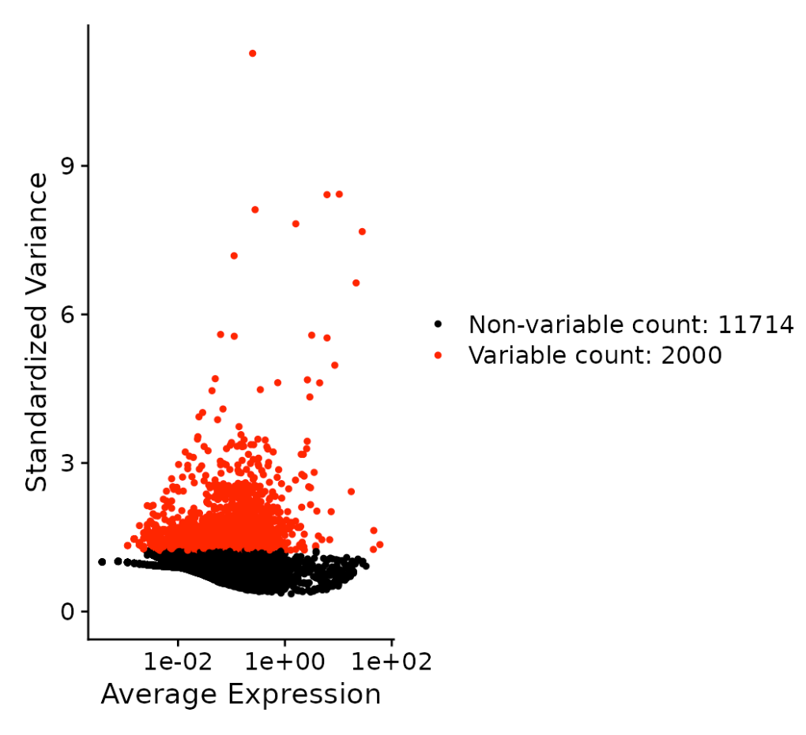
Feature Selection
Select genes that have high variability to focus on interesting biological signal for downstream steps that aggregate or cluster cells based on similarity
Not all genes necessarily contain useful information, some contain random noise
Seurat’s strategy is to pick the topmost variable 2000 genes

Slide 30
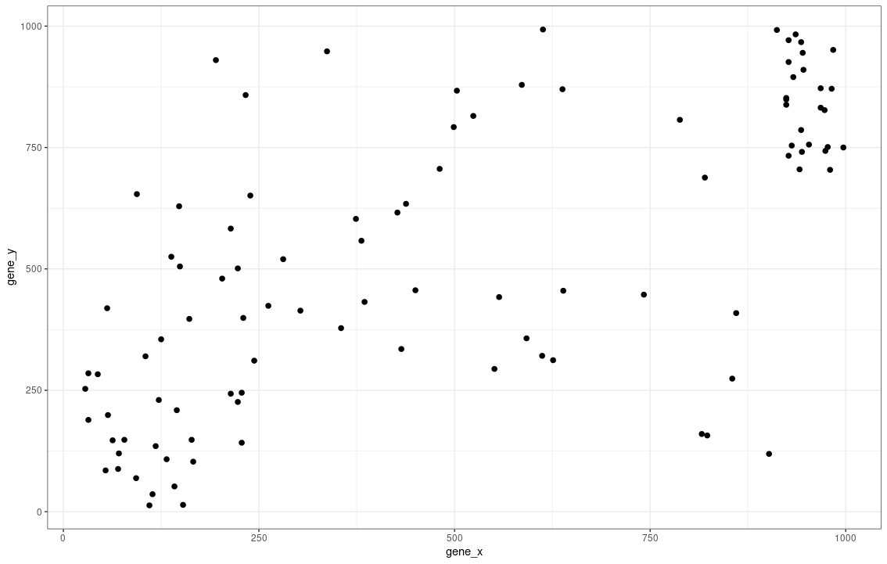
Dimensionality Reduction
If we’d only sampled 2 genes and hundreds of cells - it would be easy to plot and visualise our dataset as a 2D plot with each axis representing a gene
However, we easily profile 1000-10000+ genes in a scRNAseq experiment
If we view each gene as a dimension, cells inhabit a gene-space with 1000s of dimensions.
If genes are behaving in a correlated manner, we don’t need to store information about the individual genes and can instead create meta-features summarising this information instead

Slide 31
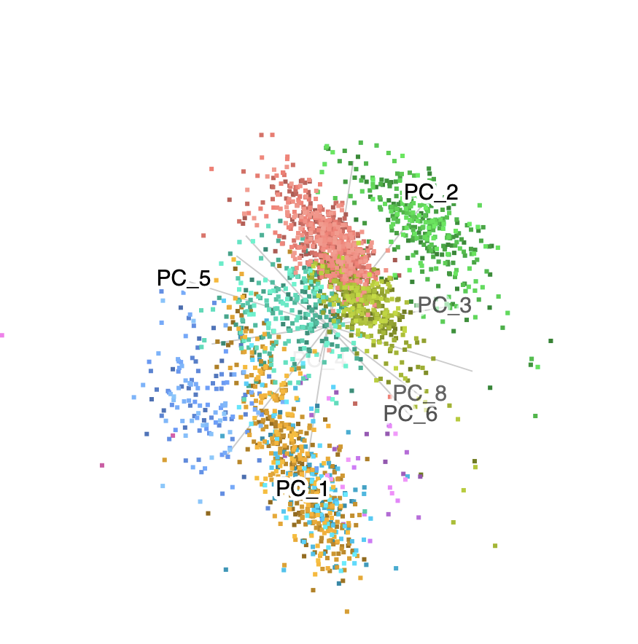
Dimensionality Reduction: PCA
Principal Components Analysis (PCA) finds axes in multidimensional space that capture the most variation in a data-set
The first axes (or Principle Components) are typically assumed to capture the dominant factors of heterogeneity in the data
Using PCA, most of the variation in a dataset can usually be summarized into 10s of components.
This is convenient for many algorithms, but still difficult to visualize...

Slide 32
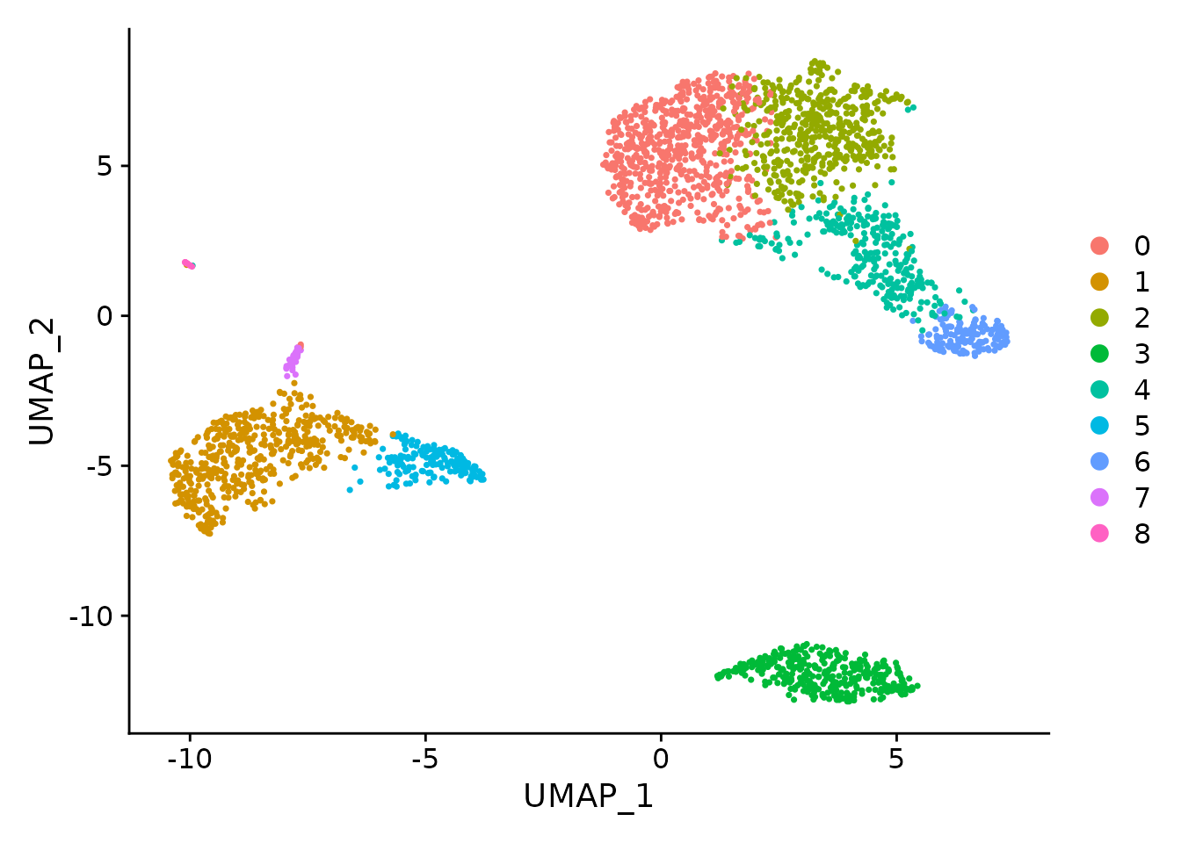
Dimensionality Reduction - UMAP
UMAP provides a further dimensionality reduction step from 10s of PCs to 2 dimensions that can be easily visualized.
UMAP is a non-linear dimensionality reduction method.
Very good at showing the structure of the data.
May arbitrarily warp and tear the data to present it in 2D.
The UMAP layout is a useful map on which other data can be shown, such as clusters or the expression of particular genes.

Slide 33
Clustering
Unsupervised learning technique to define groups of cells with similar expression profiles
Clusters are treated as a proxy for cell states
Highly dependent on parameters chosen
Methods:
Graph-based - Seurat - louvain/leiden algorithm
K-means - loupe browser

Slide 34
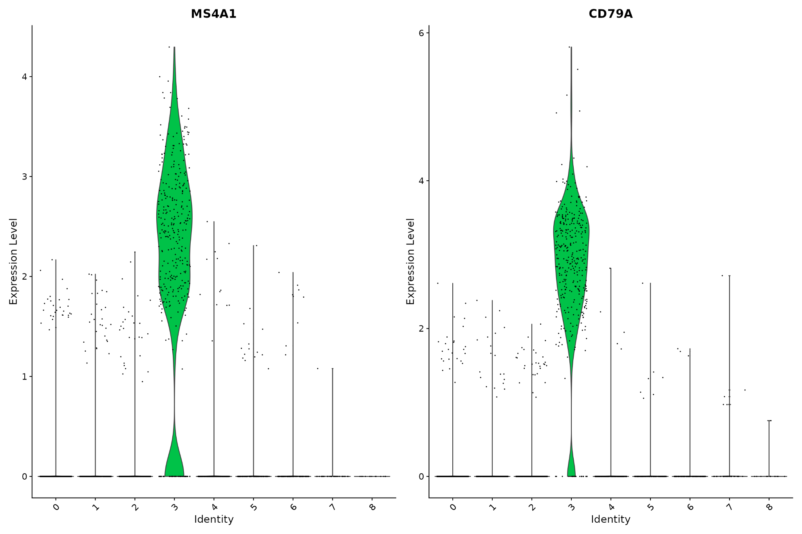
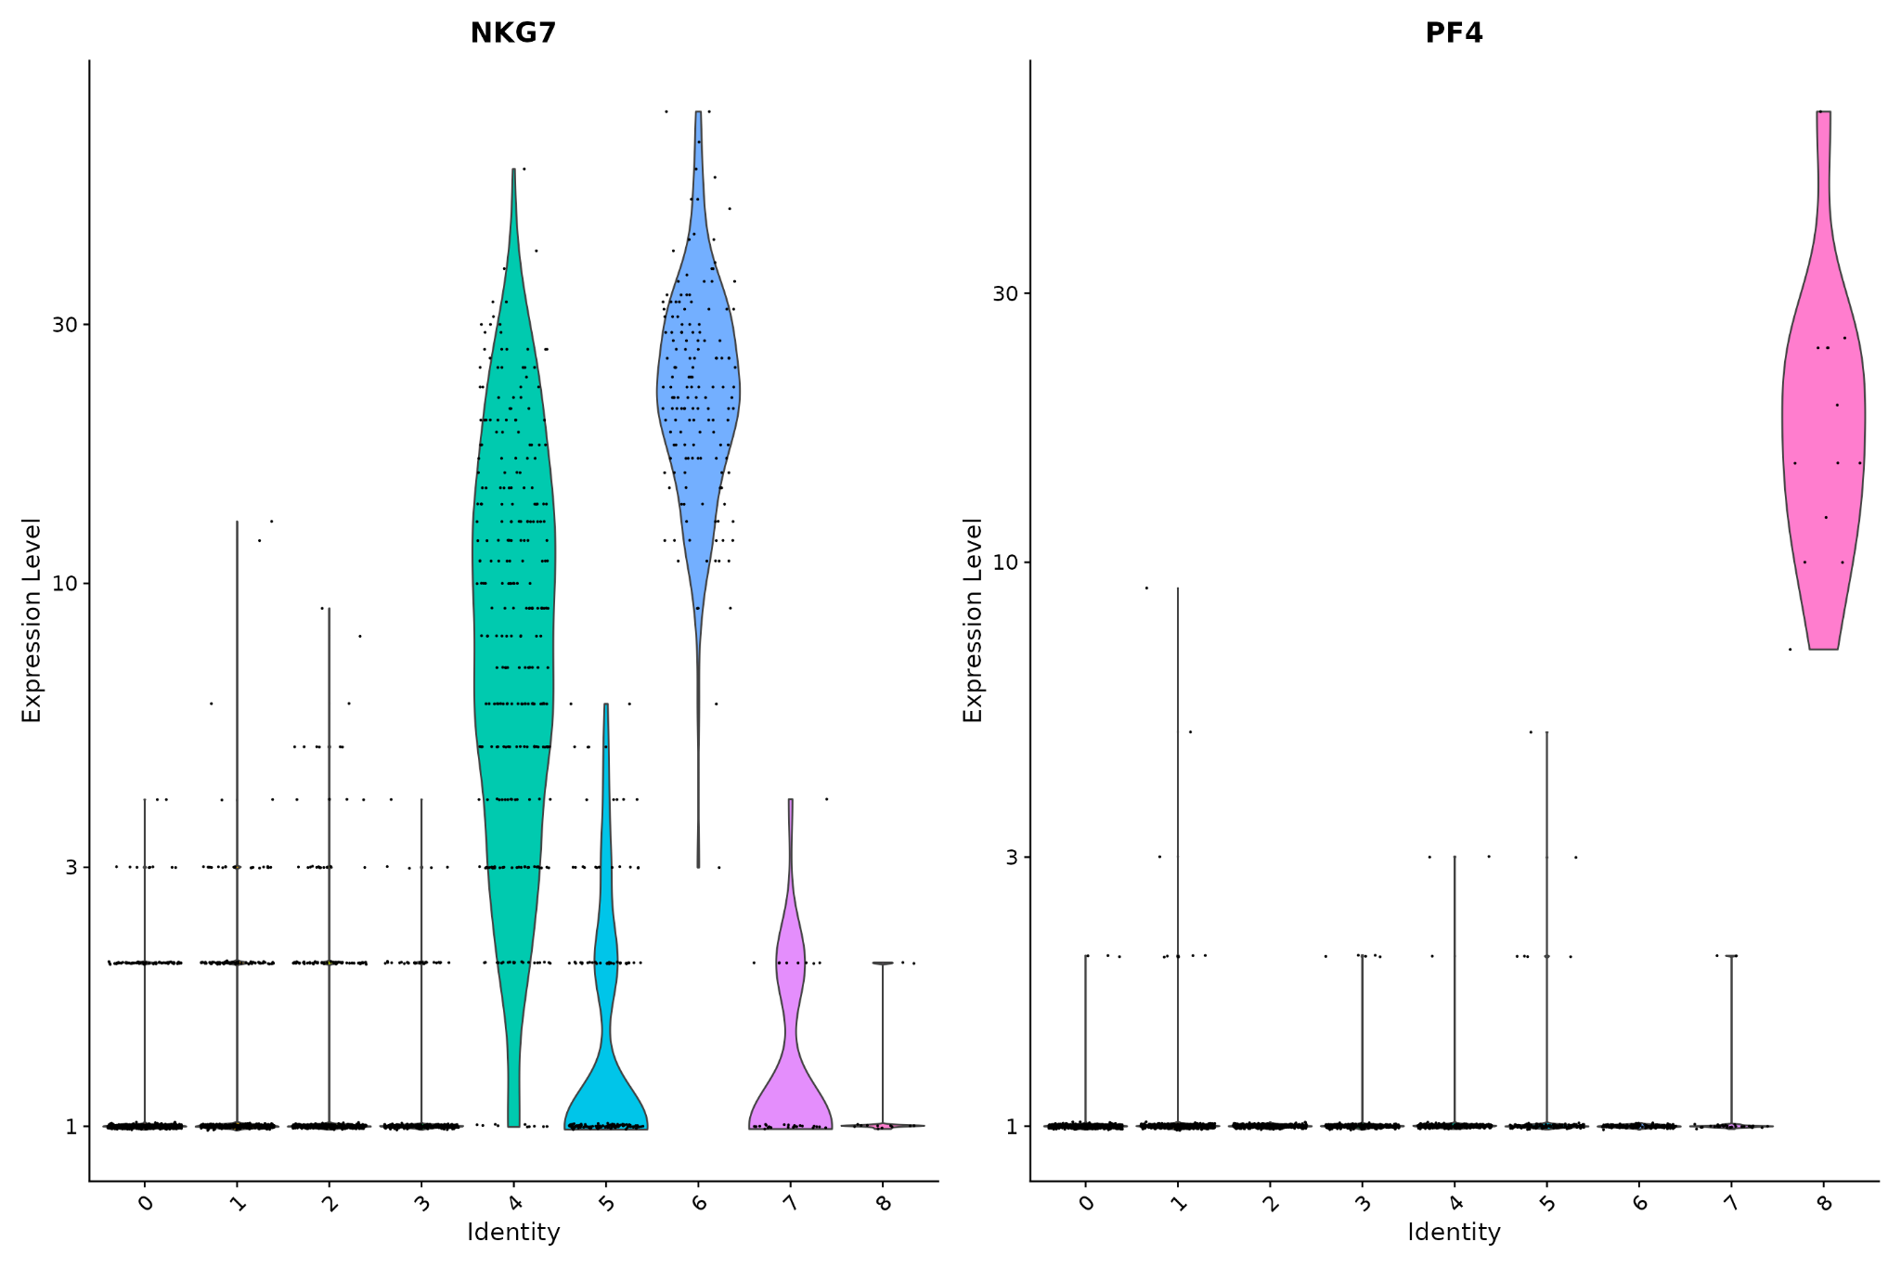
Cluster Marker Identification
Identify genes that drive the differences between clusters
Use differential tests to get potential marker gene lists - Seurat defaults to the Wilcoxon test but implements several others e.g bimod, roc, t-test, DESeq2, poisson, etc

Slide 35
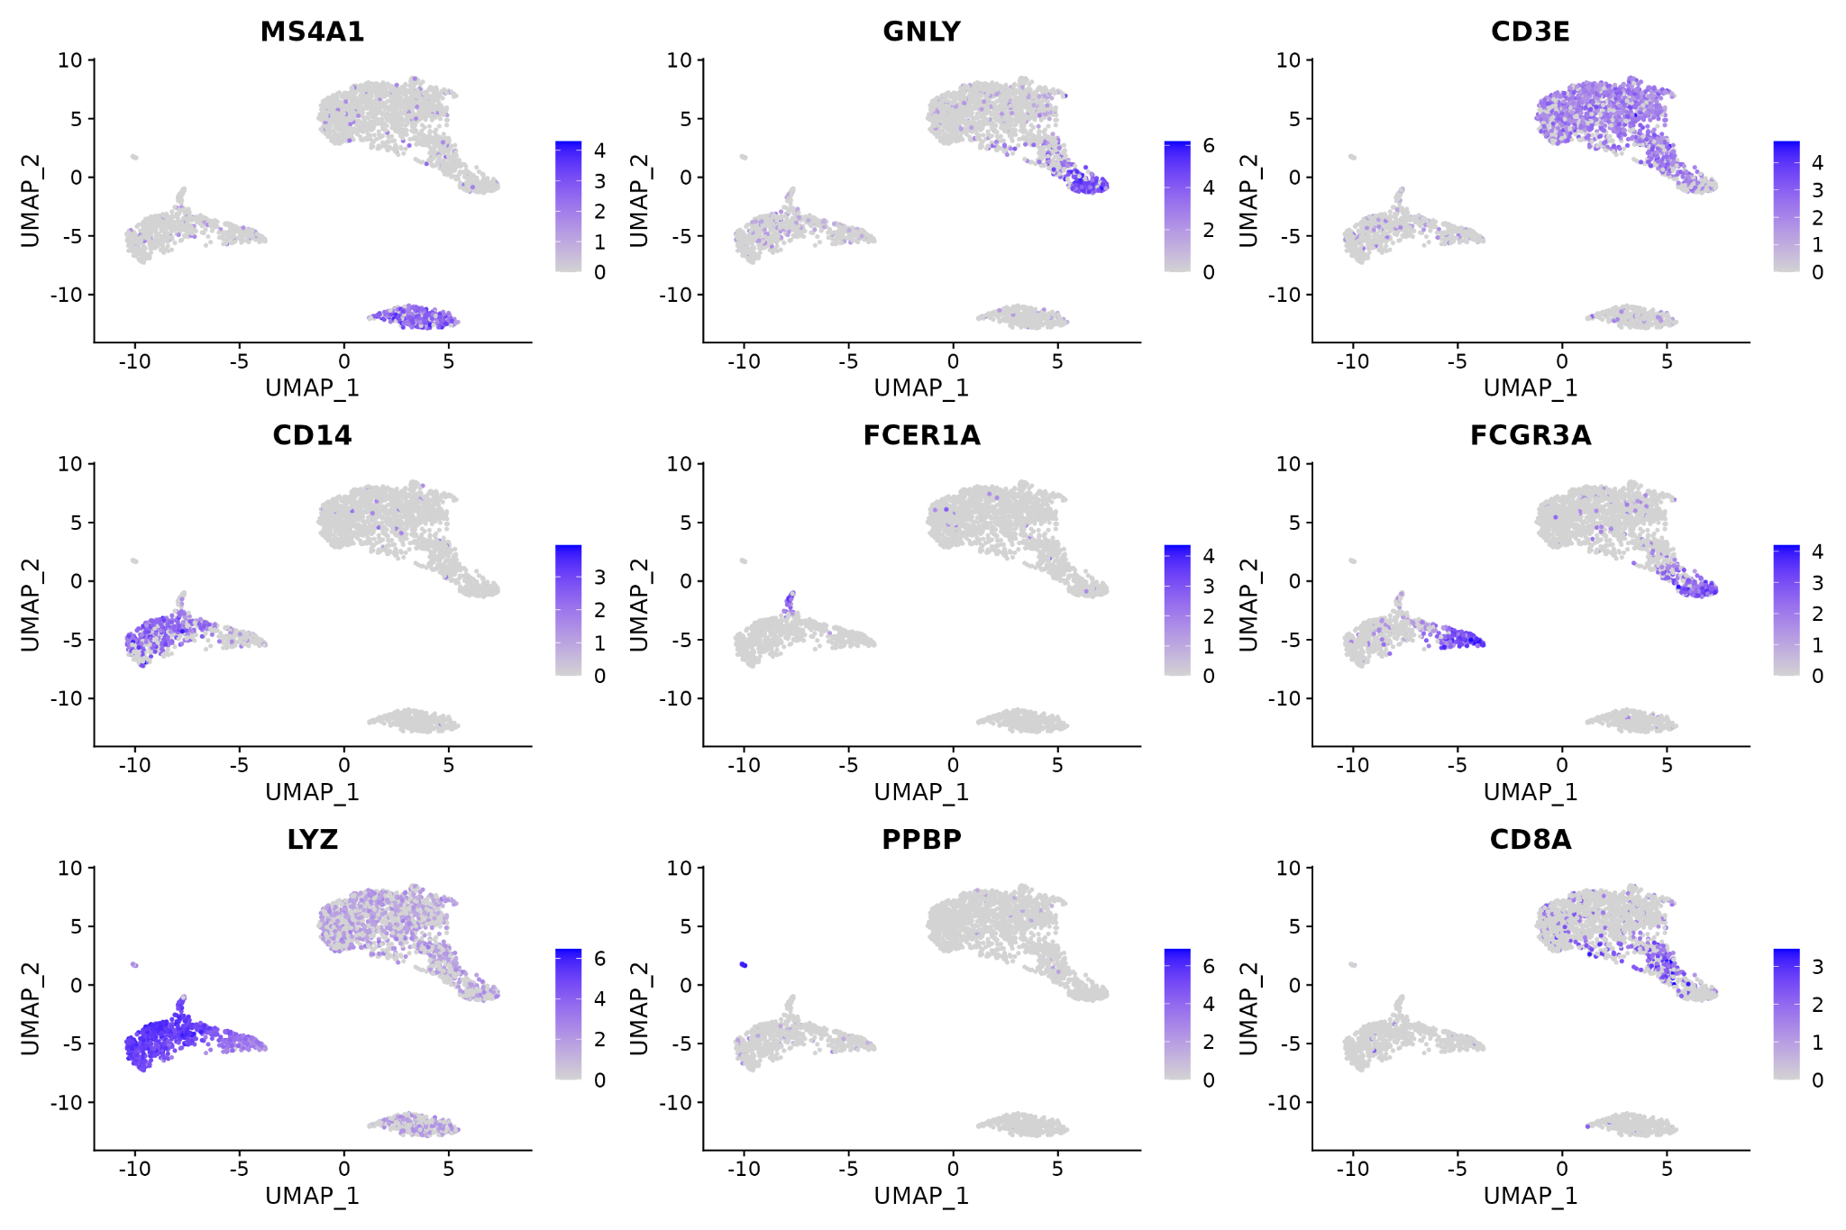
Manual Annotation
Use known cluster markers expression to determine cell type
Requires domain specific knowledge
Identifying cell types is probably the most time consuming step if you are working with uncharacterised cells
Capturing cell surface protein expression can help

Slide 36
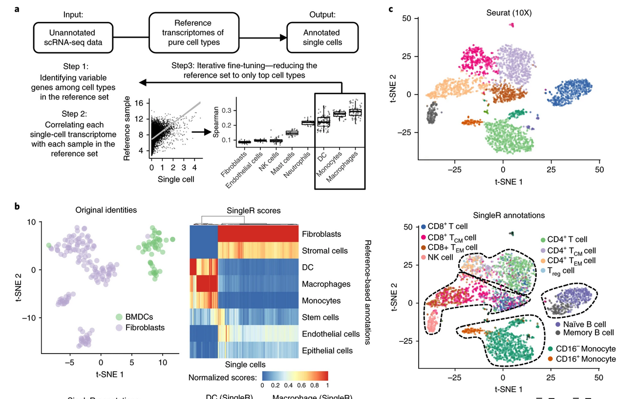
Automated cell annotation
Use a reference dataset to annotate new data
Compare the expression profile of the new dataset against the reference and classify cells in the new dataset
Tools:
singleR
Azimuth (Seurat)
scMatch
scPred
Garnett
etc
Works well when your dataset is represented in the reference
Aran, D., Looney, A.P., Liu, L. et al. Reference-based analysis of lung single-cell sequencing reveals a transitional profibrotic macrophage. Nat Immunol 20, 163–172 (2019).

Slide 37
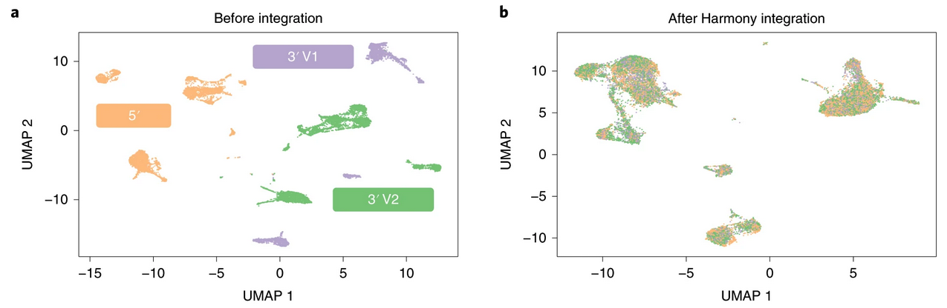
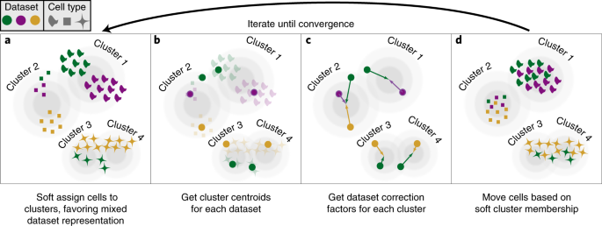
Dataset Integration
Samples from different experiments can have substantial batch effects that need to be corrected before the data can be jointly analysed
Tools:
Seurat
Harmony
batchelor
bbknn
etc

Slide 38
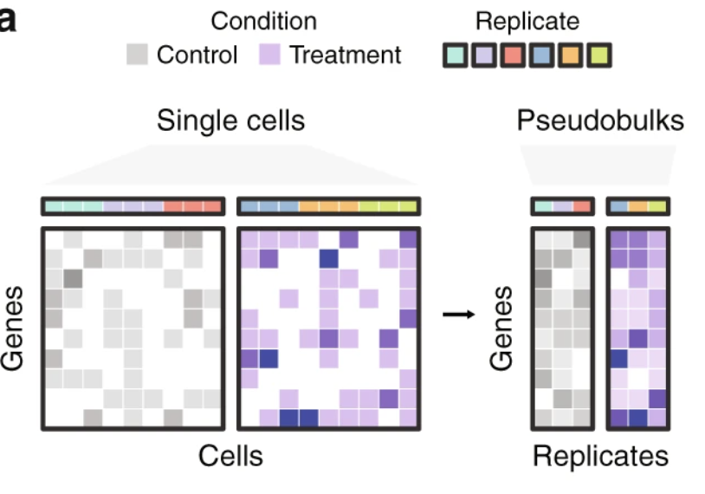
Replication
Original thought was that multiple cells provided replication
However, this is still an n = 1 and biological replicates are required to get valid p.values
Pseudobulking within a sample is reported to outperform single cell DE methods
Single cell DE methods are reported to have a bias towards highly expressed genes even when their expression remains unchanged
Squair, J.W., Gautier, M., Kathe, C. et al. Confronting false discoveries in single-cell differential expression. Nat Commun 12, 5692 (2021)

Slide 39
Have a Dialogue Going
Discuss with the biologist
Discuss with the bioinformatician
Or be both

Slide 40
Let’s Get Started

Slide 41
Workshop Reminders
Ask questions - over Slack is best!
Ask for help if you need it - helpers are available to provide help!
The learning material is freely available online - come back to it anytime
We run a help session every Friday @ 3pm - drop by if you have more questions
Single cell analysis is an ever growing and evolving field - this workshop covering how to use Seurat is just the tip of the iceberg
More
Pseudotime trajectories
Single cell velocity
Multiomics
Doublet detection
Cell cycle
Differential accessibility
Immune Profiling
Hashtag demultiplexing
Spatial
Pseudobulk
etc…

Slide 42
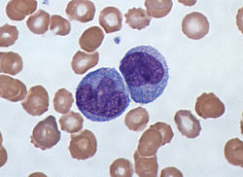
Tutorial: Dataset
Human Peripheral Blood Mononuclear Cells (PBMC) freely available from 10X Genomics
There are 2,700 single cells that were sequenced on the Illumina NextSeq 500
PBMC - typically a mixture of lymphocytes and monocytes, commonly used in immunology research
Tutorial goal: identify the cell types in this PBMC sample

Slide 43
The Seurat Object
A collection of tables and other types of unstructured data
These tables are stored under ‘slots’
The ‘assays’ slot contain data-frames associated with count data - the raw counts, normalised counts and scaled counts. If the dataset is multi-omic, you can store multiple assays e.g RNA, ATAC, cell-surface protein
Meta-data - stores cell-barcode information
The ‘reductions’ slot stores data-frames generated from dimensionality reduction steps
A Seurat object has an ‘active.assay’ - this can be overridden and changed at any time. It controls the default assay that Seurat functions will use for plotting or calculations

Slide 44
Further Resources
Orchestrating Single Cell Analysis: this is one of the most comprehensive resource on learning about single cell analysis. It utilises the Bioconductor ecosystem but is well worth reading even if you stick with Seurat or use scanpy
Seurat & Signac websites: lots of documentation on how to use these packages
Ming Tang’s scRNA analysis notes: huge list of single cell tools, tutorials, papers, etc organised by topic
Awesome single cell: another extensive list of single cell tools, tutorials, papers, etc organised by topic
scRNA-tools: a database that catalogues tools for analysing single-cell data

